Slide 1

MSTICPy – building an infosec library for Jupyter notebooks
Ian Hellen – Principal Software Development Engineer
Microsoft Security Research
@ianhellen (twitter for the moment)

Slide 2
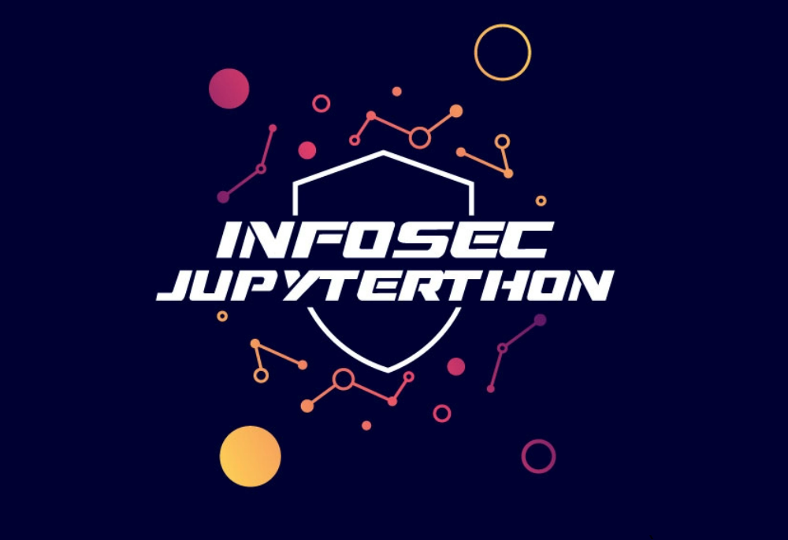
MSTICPy
Open Source Python library
Infosec tools for Jupyter notebooks
“…what might seem to be a series of unfortunate events may in fact be the first steps of a journey.”
Lemony Snicket – A Series of Unfortunate Events

Slide 3
The beginnings
We sold the Sentinel product team on Jupyter notebooks as a way to explore InfoSec data for hunting and investigation
But then we had to create some notebooks…
The results:
“Ambitious and innovative” but
- Very high Code/Signal ratio
- Intimidating to look at and to replicate

Slide 4
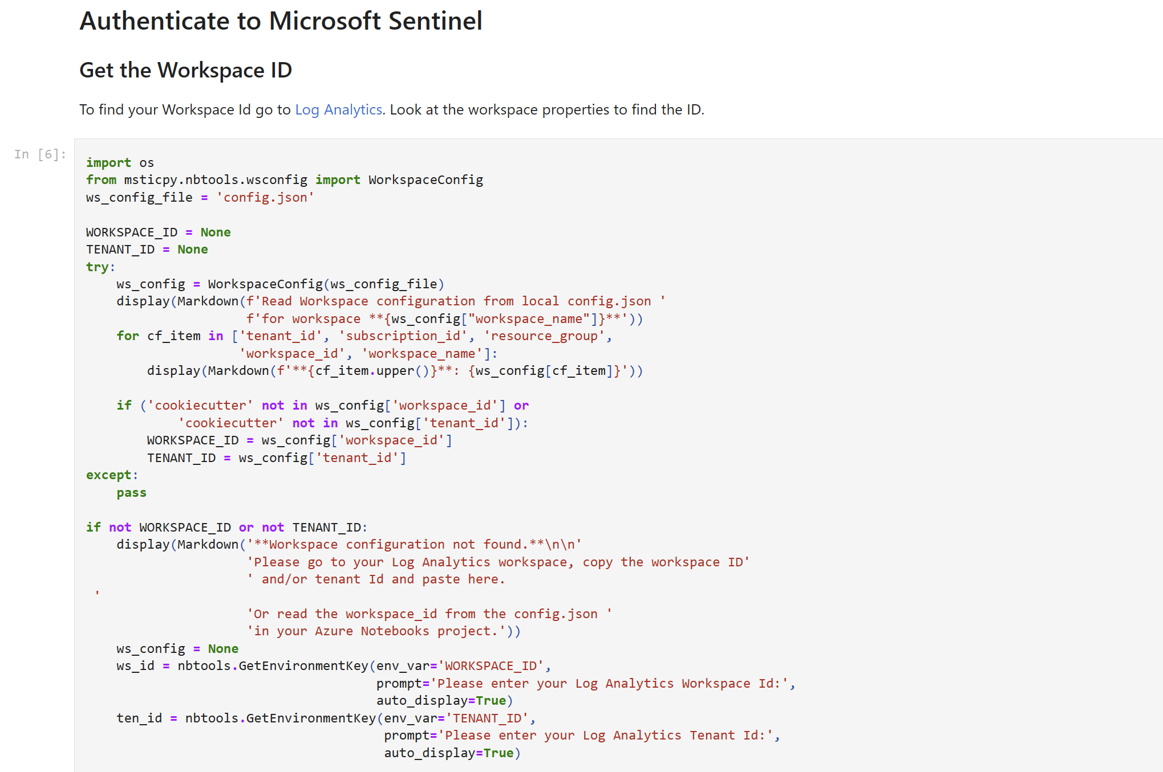

Slide 5
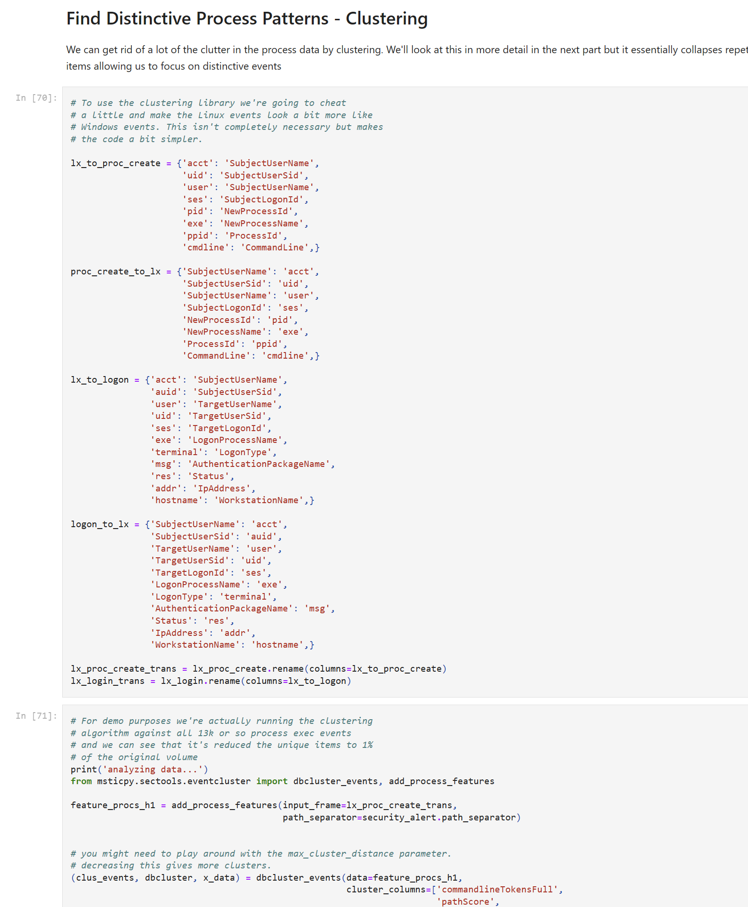
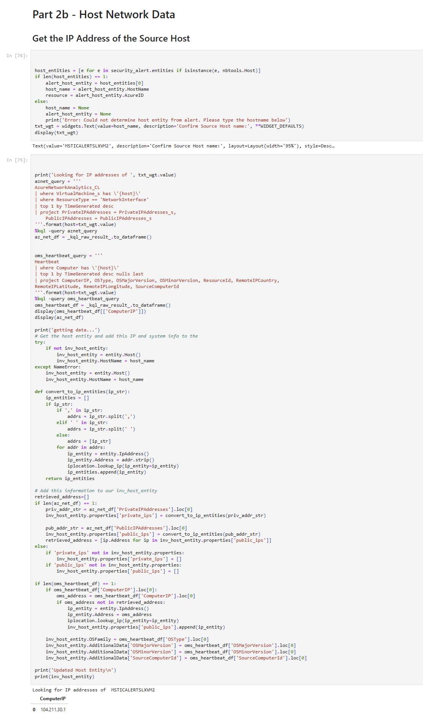
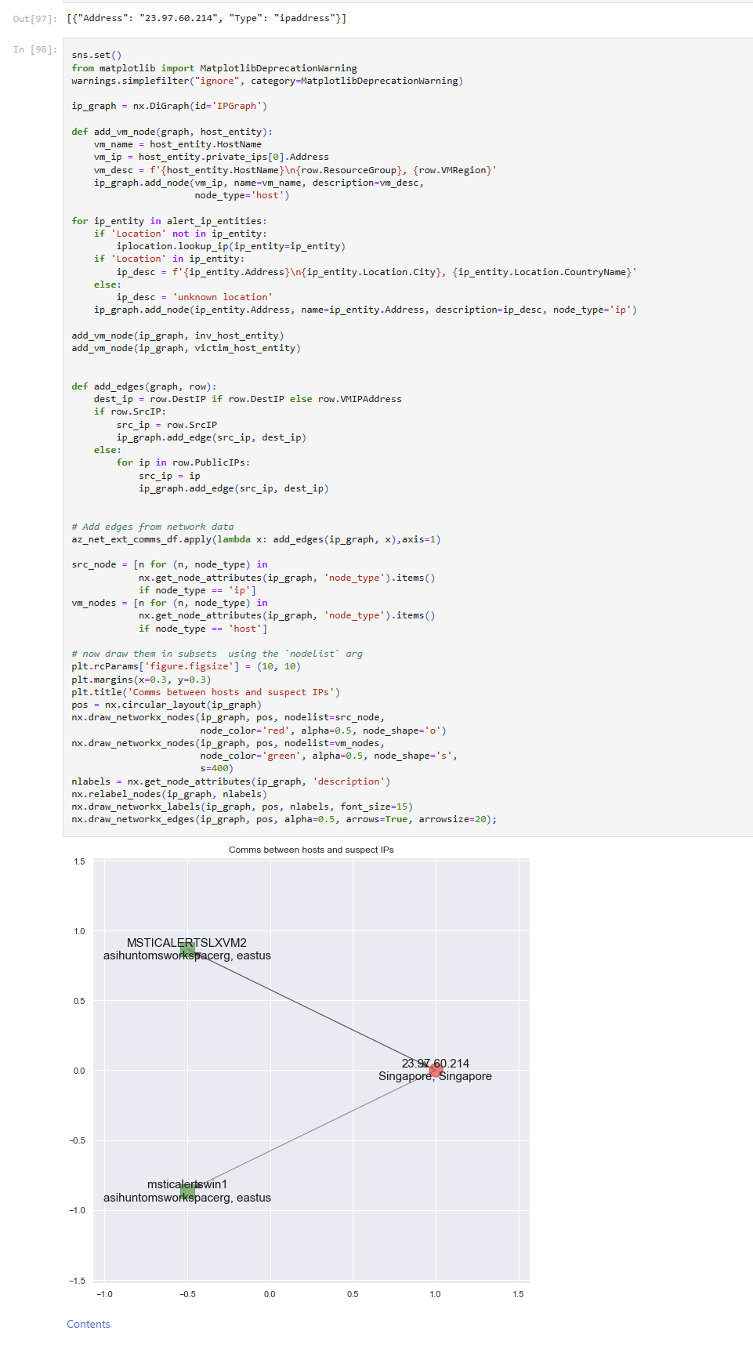
Notes:
Look at that just to get an IP Address
Or this to create a simple visualization
To do this you need both time and expertise.

Slide 6
Phase 1: origins of MSTICPy
Clean up notebooks (remove code) from notebooks
Make things testable
Allow re-use
Create InfoSec-specific functionality (vis, data, enrichment)
Give back to OSS and Infosec communities

Slide 7
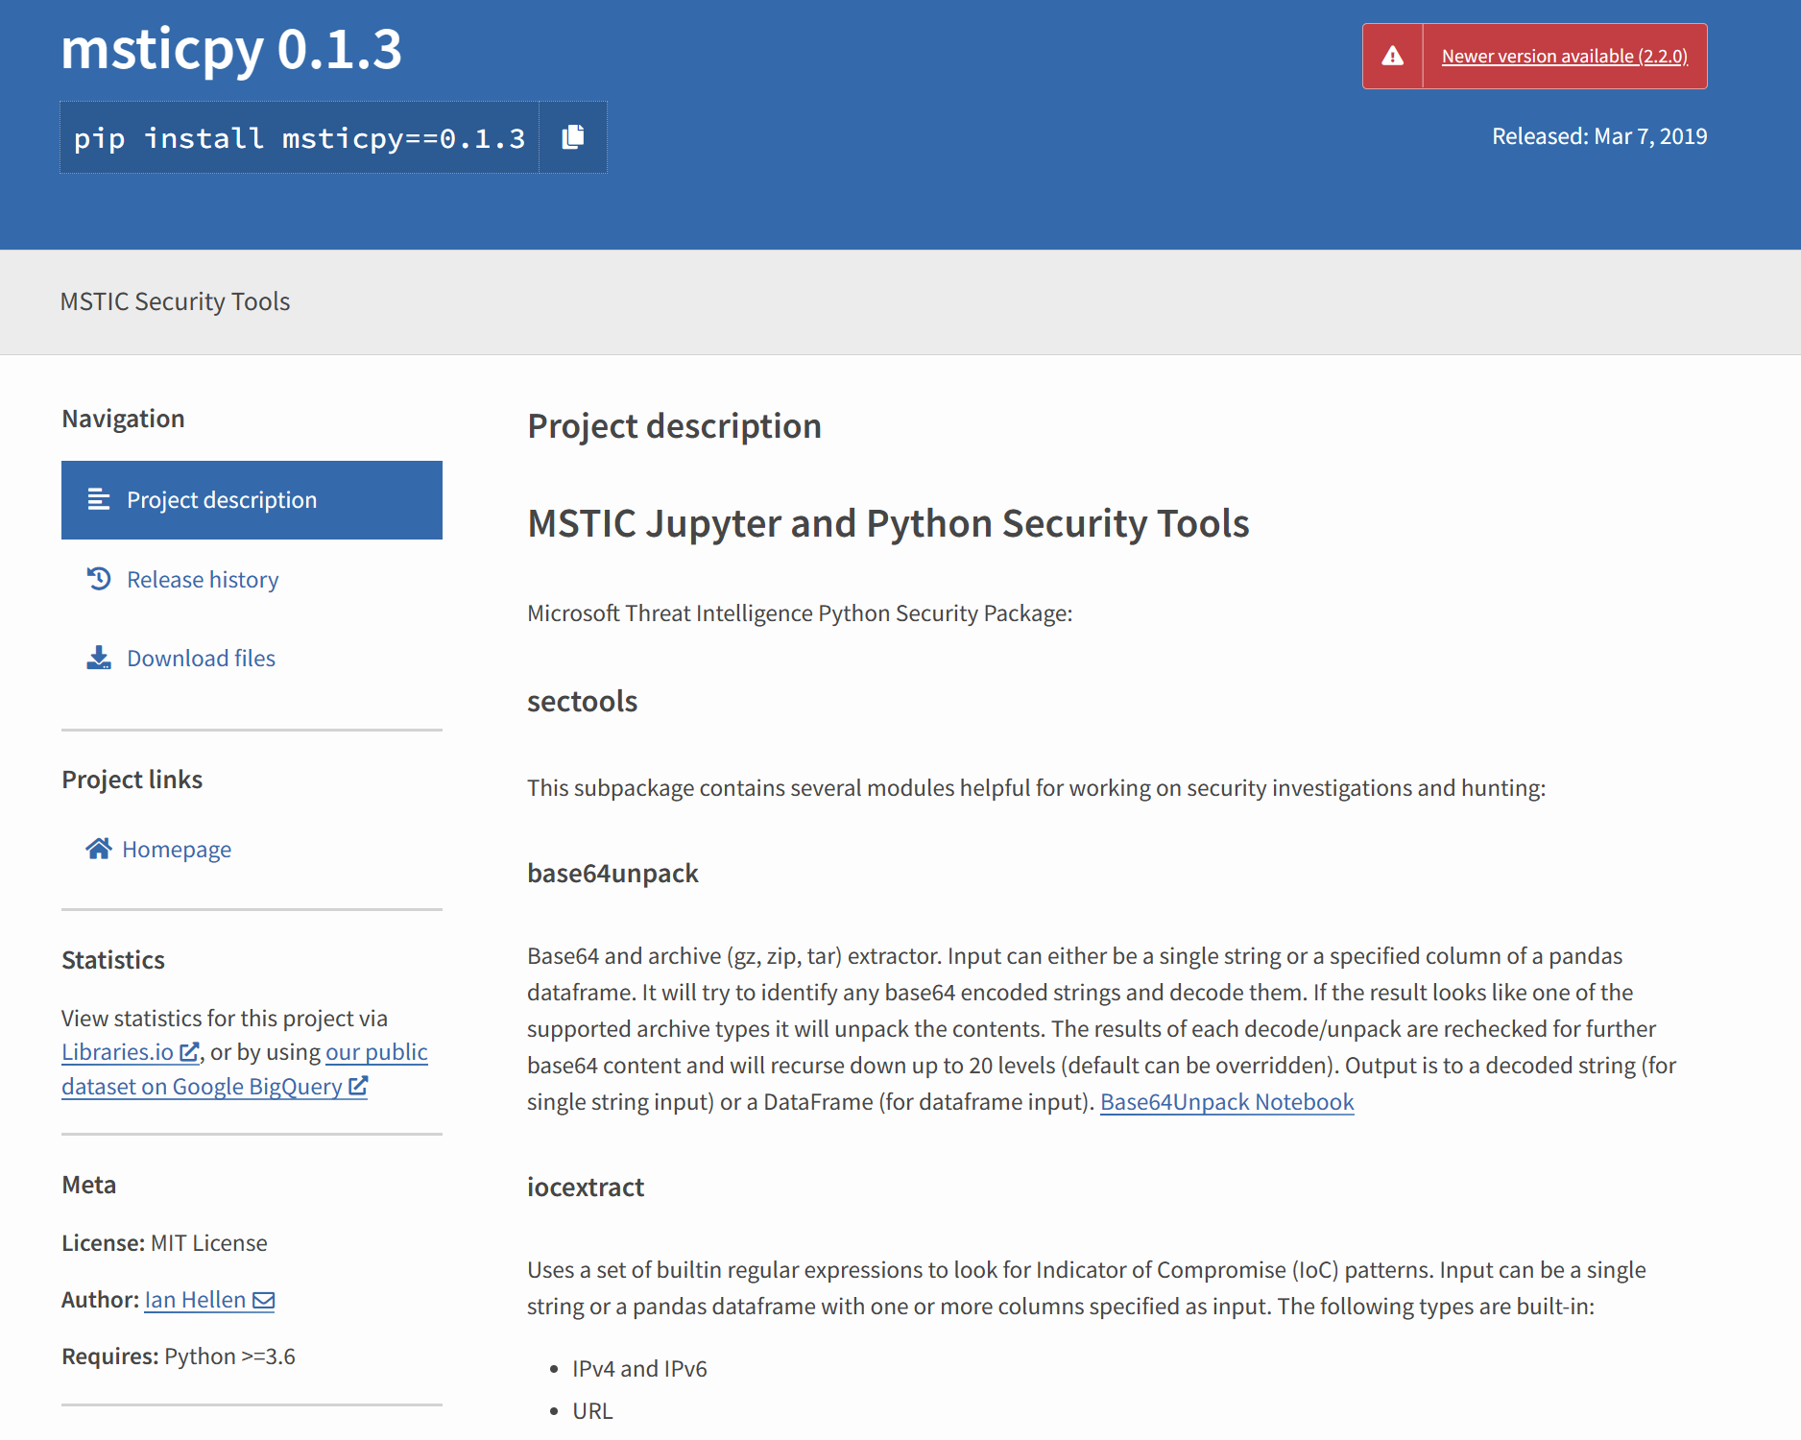
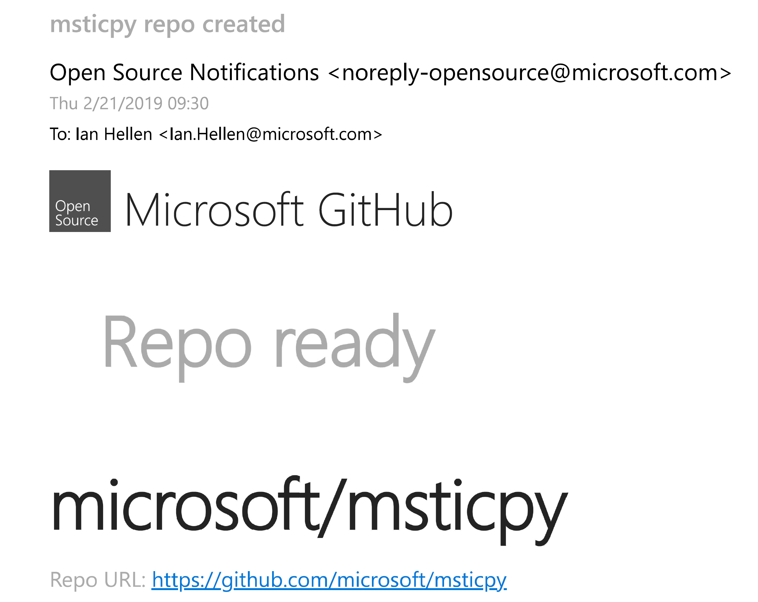

Slide 8

Jupyter as a challenging hike
John Lambert Jupyterthon 2021 Keynote
Photo: Justin Buisson

Slide 9
The Journey
Productivity
The Plateau
"I'm using it, but everything I need is not available for it"
4
The Chasm
"I feel less productive. How do I stick with it?"
3
The Ridge
"Can't relate to those who don't work the way I do"
1
2
The Parking Lot
"I'm not a programmer"
"No time to learn it"
"No management support"
"Where do I start?"
Time
Notes:
People’s first reaction to notebooks is WOW – closely followed by “this is really difficult”. The initial complexity and foreignness of the environment means that most people never get started
Many of those brave enough to embark on the trail get mired early on because everything seems more difficult than traditional SOC tools that they are used to
A bit of clarity – you glimpse a nice view of what you are going to see from the top but there are still things missing.
You are now pretty comfortable with notebooks but still struggle to get them adopted more widely in your organization.

Slide 10



Our Journey
Productivity
The Plateau
"I'm using it, but everything I need is not available for it"
If
4
The Chasm
"I feel less productive. How do I stick with it?"
3
The Ridge
"Can't relate to those who don't work the way I do"
1
2
The Parking Lot
"I'm not a programmer"
"No time to learn it"
"No management support"
"Where do I start?"
If you’re going on a hike, you don’t
want to have make your own hiking boots, etc.
Time
Notes:
A lot of our potential users were still firmly in the parking lot,
With a few making it into the foothills and beyond.
If notebooks are going to be successful, we need to find a way of propelling more people up the mountain.
Notebooks can look a little like a set of ingredients to make your own hiking gear.
Few people want to do that just to get to the top of mountain.

Slide 11
Phase 2: generalizing functionality
Starting point:
Many components (e.g. visualizations) would only work with Sentinel
Functionality often Windows-centric
Limited set of data sources
Sentinel notebooks environment was hard to get going
people could not get out of the parking lot

Slide 12
Phase 2: achievements
Data providers for Splunk, Microsoft Defender, Sumologic, MS Graph and others
More support for Linux queries and Linux-friendly functionality
More Threat Intel providers
More visualizations – Timelines, Process Tree
Configuration file
msticpy.init_notebook()
To automate setup for typical notebook use
Extra support for Sentinel/Azure Machine Learning/Azure Synapse

Slide 13
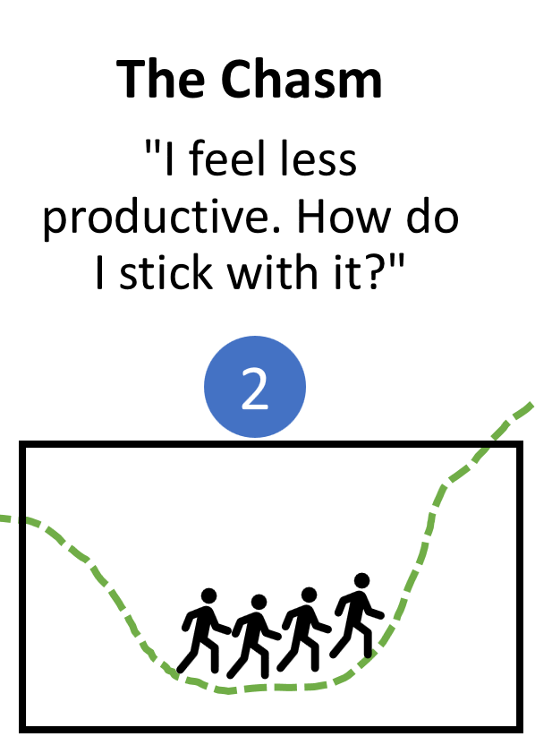
Phase 2: where were we on the journey?
A lot of functionality but bewildering
Need to know what something is called and where to import from
Need to know component-specific syntax
Often required some kind of prep
instantiating a class
formatting or converting data
Output in unpredictable format (dict, tuple dataframe, etc.)

Slide 14
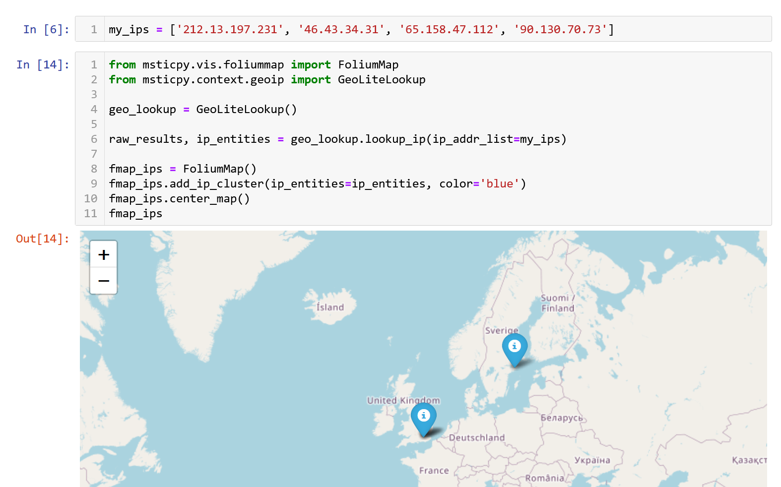
Example
Need to know where these are
Have to instantiate classes
Have to know parameter name
Returns a tuple – of which you need only one element
Create instance, add the IPs, center and display
Pieces of knowledge needed:
2 imports, 2 targets
2 class instantiations
2 function signatures
1 return format
1 utility function
How to display
= 11 items!!!!

Slide 15
Making the ascent easier
Ad hoc notebooks
Writing re-usable notebooks
Allow analyst to focus on investigation/hunt not on how to use the tools
Add/use functionality with minimal distraction
Reduce need to lookup docs
Keep code blocks succinct

Slide 16
Phase 3: getting out of the chasm
Simplify entry points
Reduce the number of entry points
Make the entry points intuitive (e.g. IP functionality part of the IpAddress class)
Remove or simplify initialization steps
Import common items automatically (in init_notebook)
Avoid need to instantiate classes
Simplify function behavior
Functions allow flexible input (single value, iterable/list, dataframe)
Normalized parameter names (not quite there yet)
Predictable output (everything is a DataFrame)
Built-in help and friendly exceptions

Slide 17
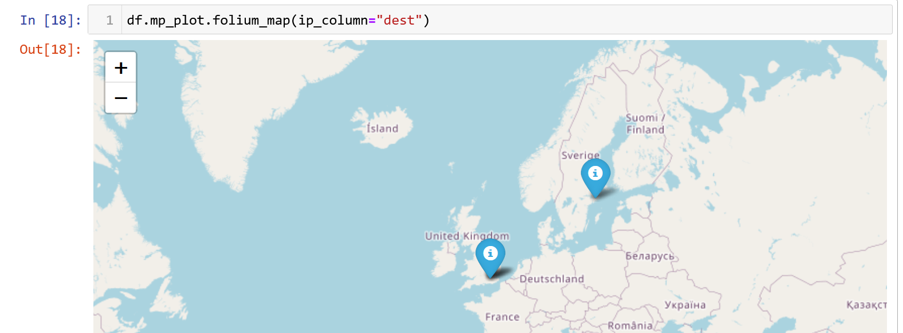
1. Simplify working with data
We took the decision early to treat pandas DataFrames as universal interchange format for bulk data
Why not add data-related processing and visualization as pandas extension methods?
MSTICPy visualization functions:
df.mp_plot.folium_map
df.mp_plot.incident_graph
df.mp_plot.matrix
df.mp_plot.network
df.mp_plot.process_tree
df.mp_plot.timeline
df.mp_plot.timeline_duration
df.mp_plot.timeline_values

Slide 18
2. Simplify working with entities
A lot of our work is entity-related: IPs, Accounts, Hosts, Urls, etc.
Why not group entity-specific functionality on entity classes?
Also:
Make input parameters the same signature/names
Support single value, lists, dataframes as inputs
Make output format the same (a DataFrame, of course)
Add relevant data queries
Let users add their own functions

Slide 19
A bit more complex than pandas extensions
Some bits of Python dark magic needed to pull this off
Function wrapping – aka decorators
The idea:
Take a function F
Wrap F in a decorator D_{in} that handles single values, iterables or DataFrames (calling the function multiple times and gathering results)
Wrap this another decorator D_{out} that takes the function output and converts to a DataFrame
F => D_{out}( D_{in}( F(args) ) )
Then attach the wrapped function to the entity
setattr(IpAddress, “geoip”, geolite_lookup.lookup_ip)
MSTICPy Pivots!

Slide 20
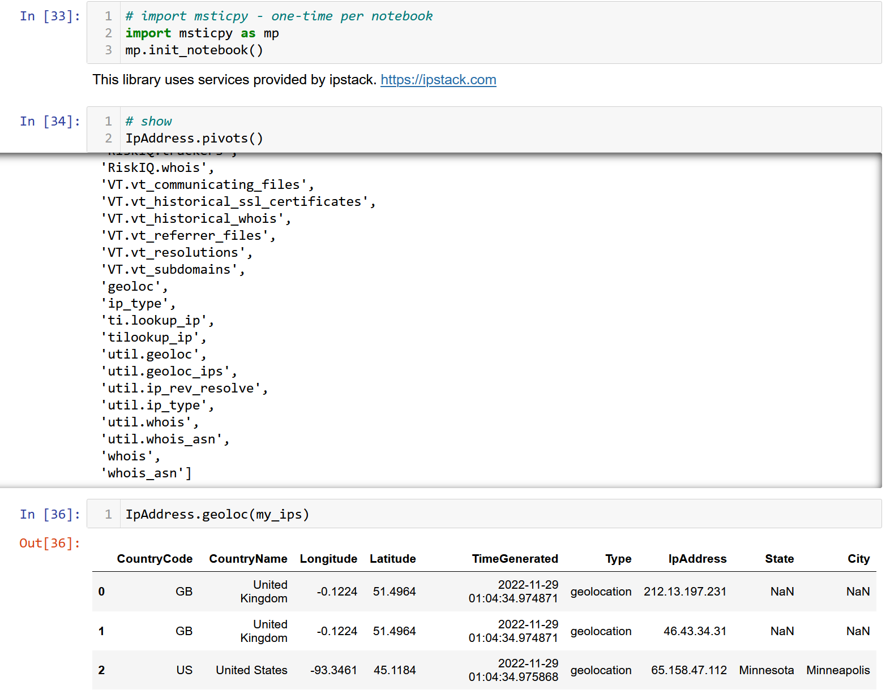
MSTICPy Pivots

Slide 21
The Future
Some things are still hard to discover or don’t fit DataFrame or pivot paradigms
Inconsistent parameter names
Still some challenges with infrastructure
Pipelines – everything understands pandas
Letting user extend functionality
Config-based TI providers
Make it easier to add custom queries

Slide 22
Conclusion
Notebooks are amazing tools for infosec hunting and investigation But the journey is challenging
Core functionality is a requirement but not enough
Make the journey more manageable by making functions:
Easily discoverable
Predictable
Simple to use – (e.g. a single line to invoke an operation)
Put in time to help others out of the parking lot – pay attention to:
Setup, install and on-boarding
Also - help MSTICPy make the “notebooks hike” less treacherous:
Critiques/Feedback
Code
Documentation

Slide 23

Thanks
pip install msticpy
Find us on GitHub https://github.com/microsoft/msticpy
Give us a star if you like it
Add an issue or start a discussion for things you want to improve
#msticpy channel on the OTR Discord server
msticpy@microsoft.com

